Slide 1
Biological plausibility of backpropagation algorithm and MLPs/Deep nets

Slide 2
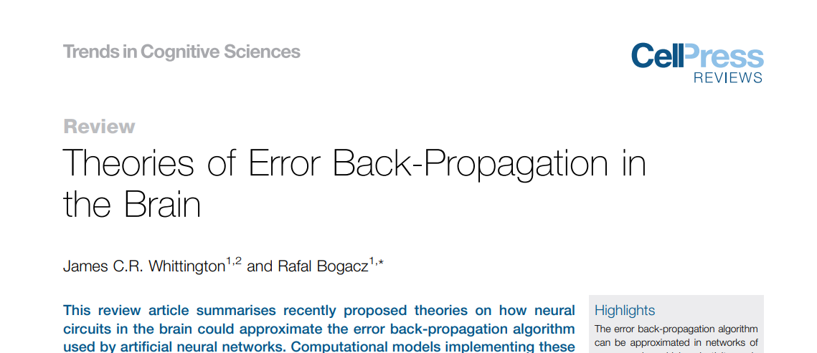
(2019)

Slide 3
Drawback of BP algorithm (Whittington and Bogacz 2019)
Lack of Local Error Representation
Symmetry of Forwards and Backwards Weights
Unrealistic Models of Neurons
Many biologically plausible architectures and learning rules have been proposed

Slide 4
What is a biologically plausible learning mechanism? Hebbian Learning
“When an axon of a cell A is near enough to excite a cell B and repeatedly or persistently takes part in firing it, some growth process or metabolic change takes place in one or both cells such that A’s efficiency, as one of the cells firing B, is increased.” (‘Organization of Behavior’ by Donald Hebb)
When two neurons are simultaneously active, the connection between them must be strengthened; when one of them is active, while the other is inactive, the connection strength must be weakened.
“Neurons that fire together, wire together.”

Slide 6
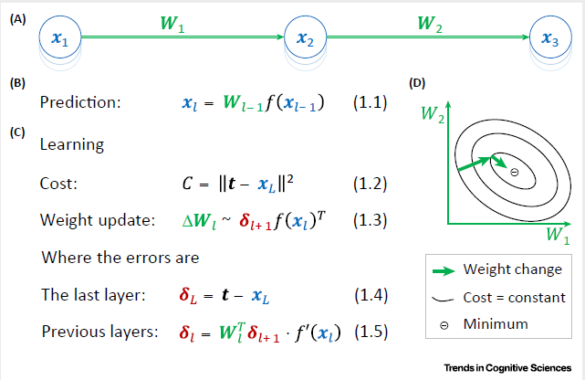
Standard Backpropagation

Slide 7
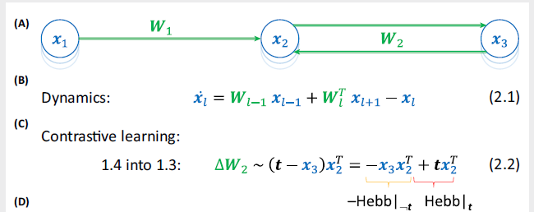

Biologically plausible version
(Whittington and Bogacz 2019)

Slide 8
Deep neural network models of sensory systems
Windows onto the role of task constraints

Slide 9
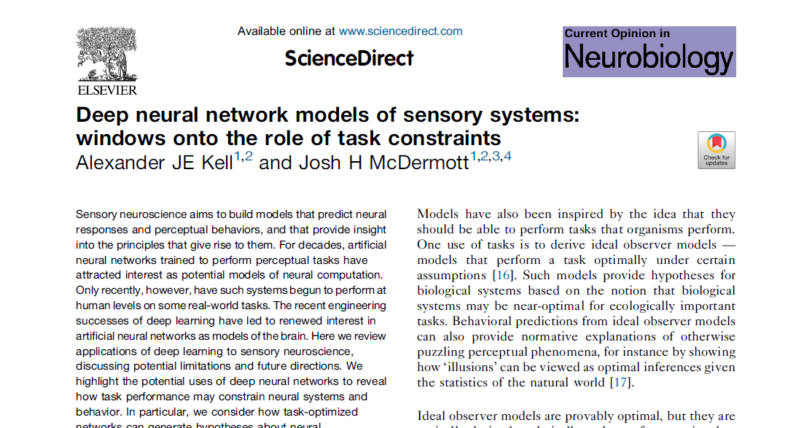

Slide 10
INTRODUCTION
Using neural networks trained on sensory tasks – to understand sensory systems in the brain
Improvement in computing speeds, GPUs etc – deep neural networks (DNN)
Using DNN to model sensory tasks performed by humans
Recently CNNs trained on these tasks have achieved human level performance.

Slide 11
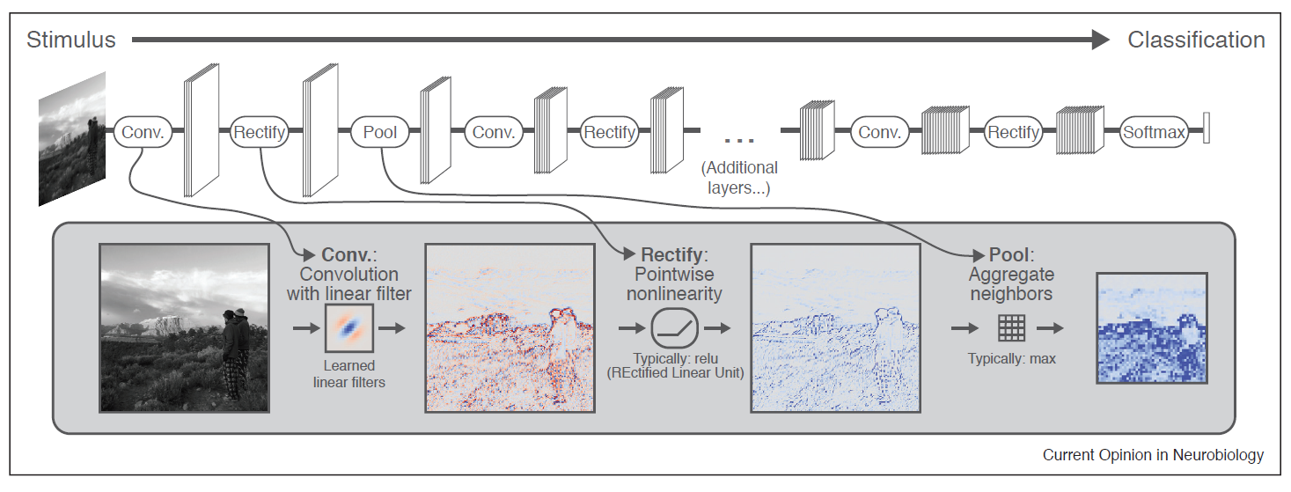
CONVENTIONAL CNN ARCHITECTURE

Slide 12
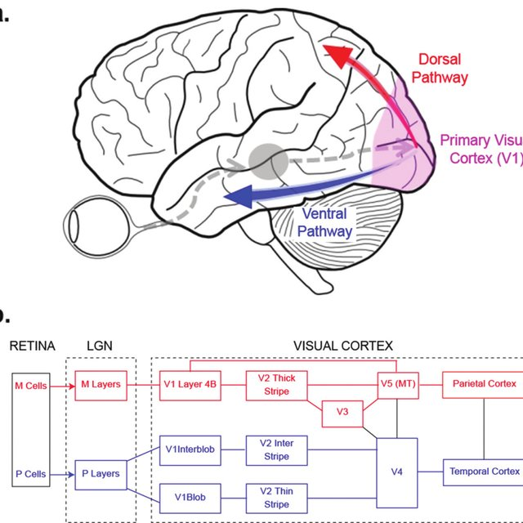

Slide 13
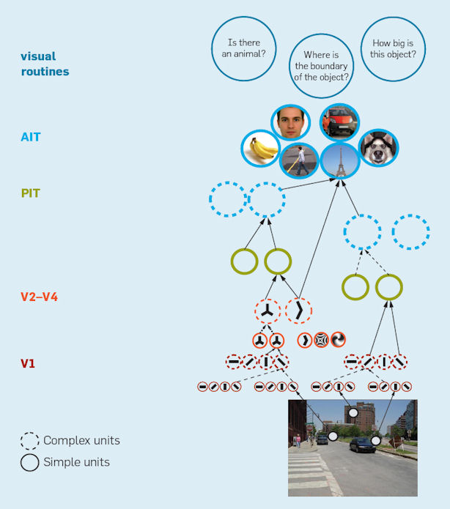
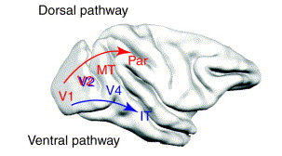
Hierarchical organization in the visual system

Slide 14
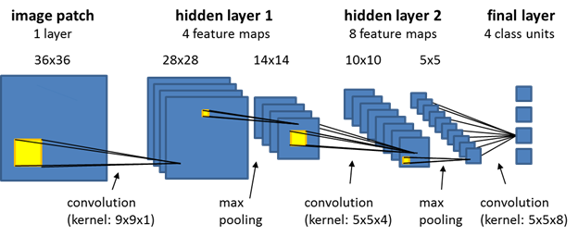
Comparing a deep network with brain’s activity
W – weight matrix
Linear Fit

Slide 15
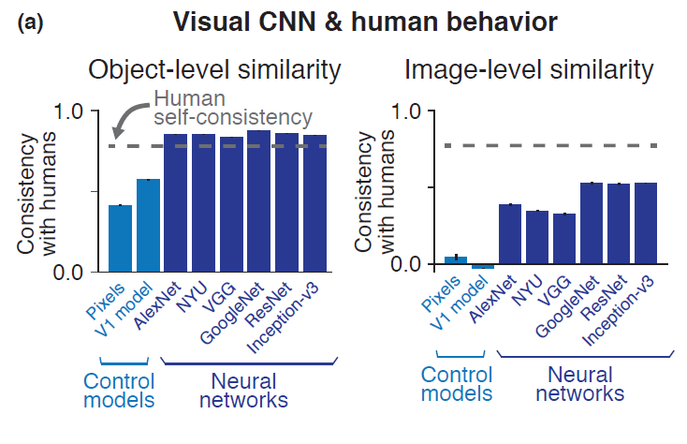
CNN AND HUMAN VISUAL SYSTEM
Performance characteristics of a human was compared with a deep neural network.
Visual object recognition was the task used
Similar error was observed between humans and model across object categories and viewpoint variations
Object sensitivity and similarity judgements also seemed to be similar between humans and model
However image-by-image comparison between model and humans showed lower similarity

Slide 16
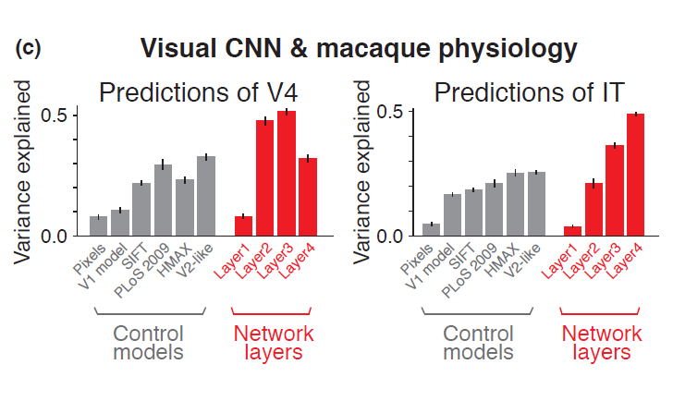
MONKEY VISUAL SYSTEM AND CNN
Different layers of the CNN were compared with the visual areas in a monkey
Layer 3 similar to V4
Layer 4 – IT
DNNs proved better at explaining the visual areas than other networks and models.

Slide 17
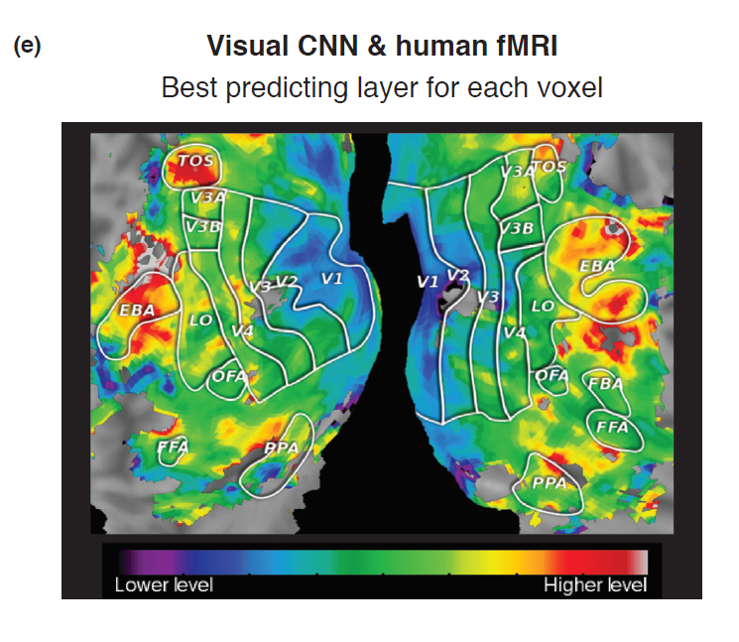
COMPARISON WITH fMRI
fMRI activity was compared with activations obtained from CNN
Network trained on images showed to participants undergoing fMRI
Activation from lower layers of the CNN similar to early layers of the human visual system
Higher level layers – higher visual areas

Slide 18
Auditory System

Slide 19
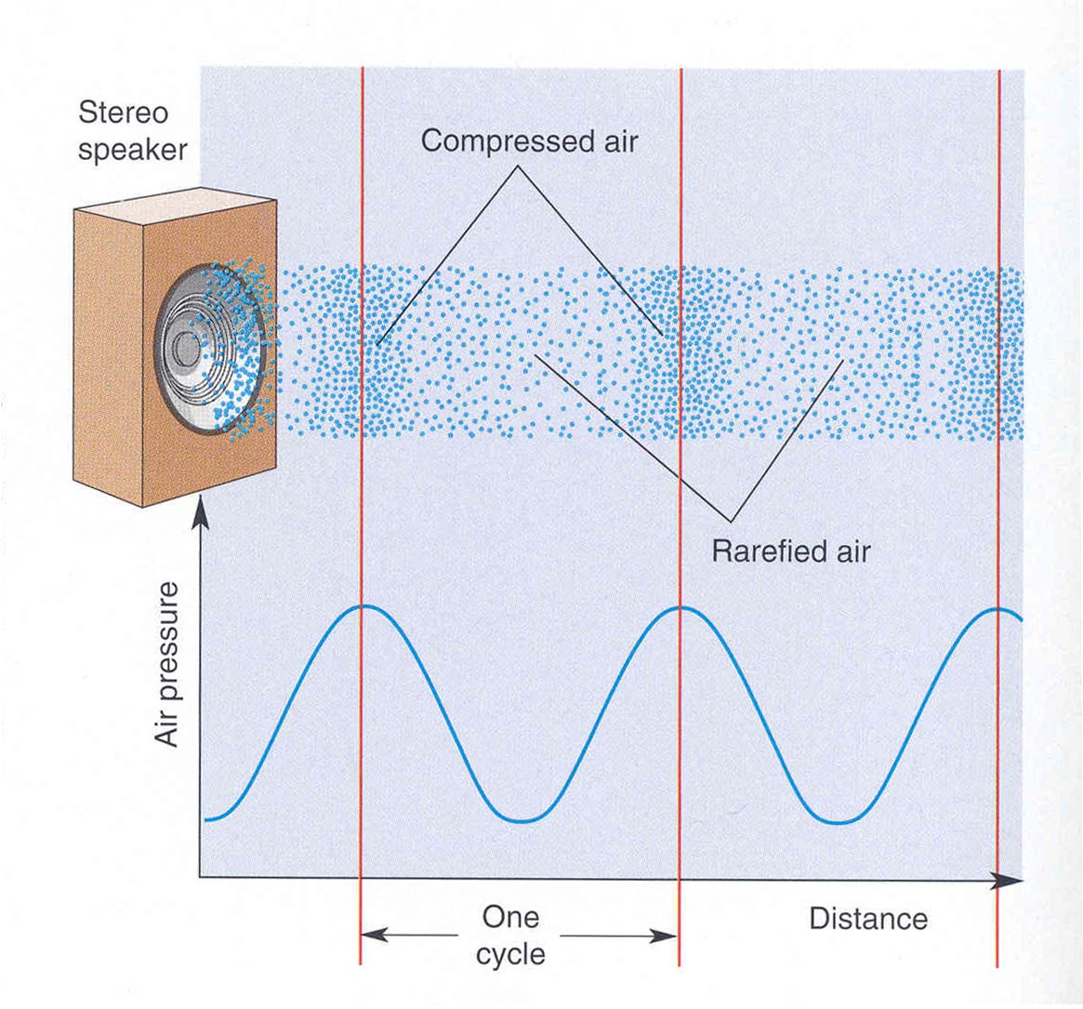
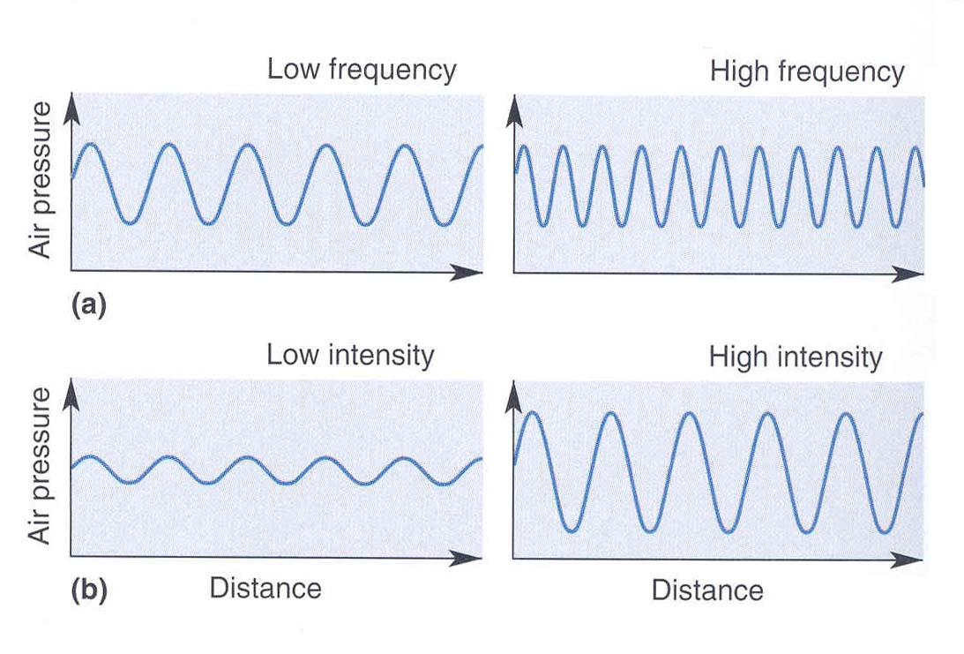
The Auditory System
http://www.med.uottawa.ca/courses/nsc5104/assets/documents/AuditorySystem.ppt
Sound is created by pressure waves in air; these waves are induced by vibrating membranes such as vocal cords. Because the membranes usually vibrate in a regular manner, the pressure waves have a fixed spacing.
Sound has two main characteristics: A. the spacing between waves or period. This can also be thought of in terms of how many wave cycles pass by in one second - that is, the sound’s frequency in Hz=cycles/second.
B. The intensity of amplitude of the sound measured in decibels.
Bear et al.

Slide 20
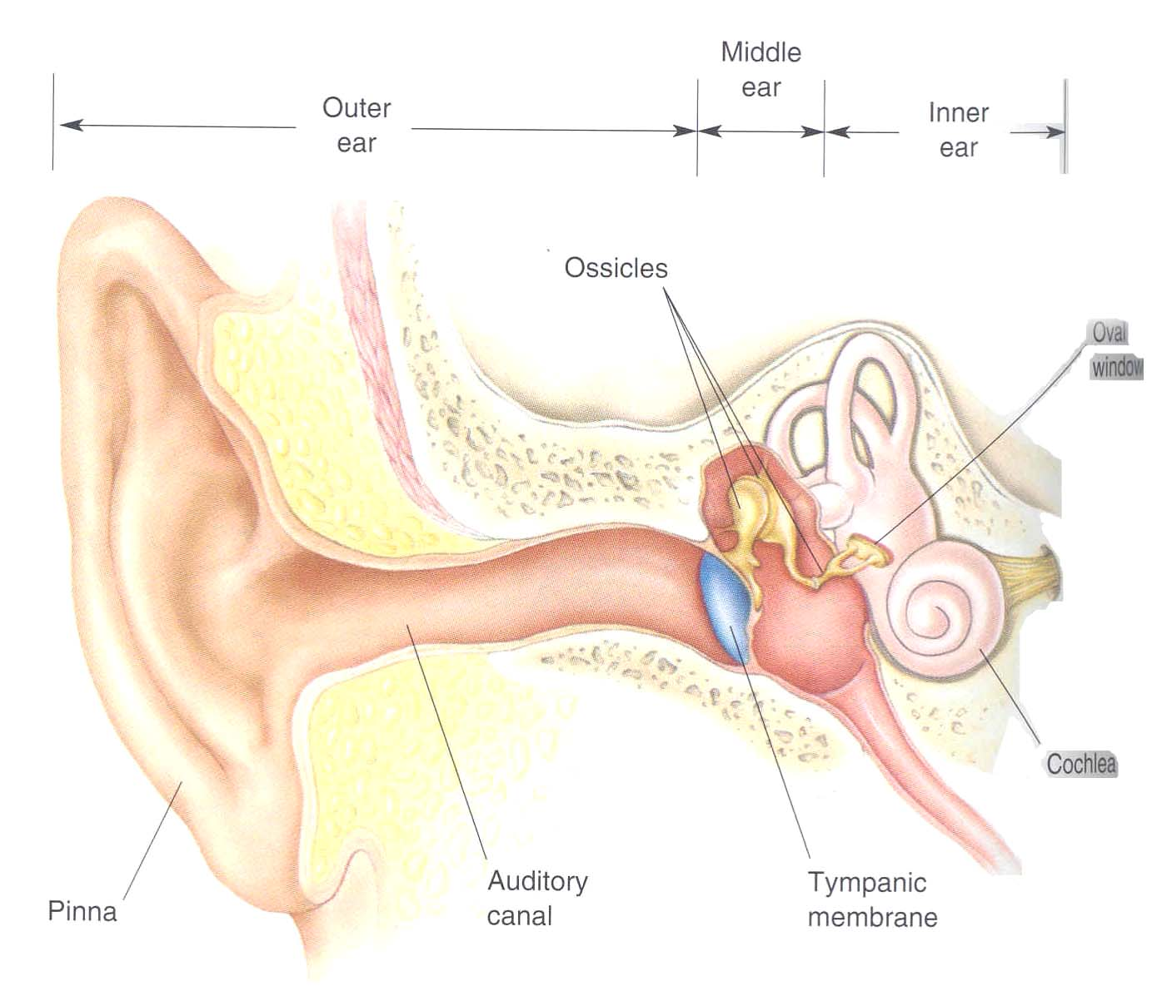
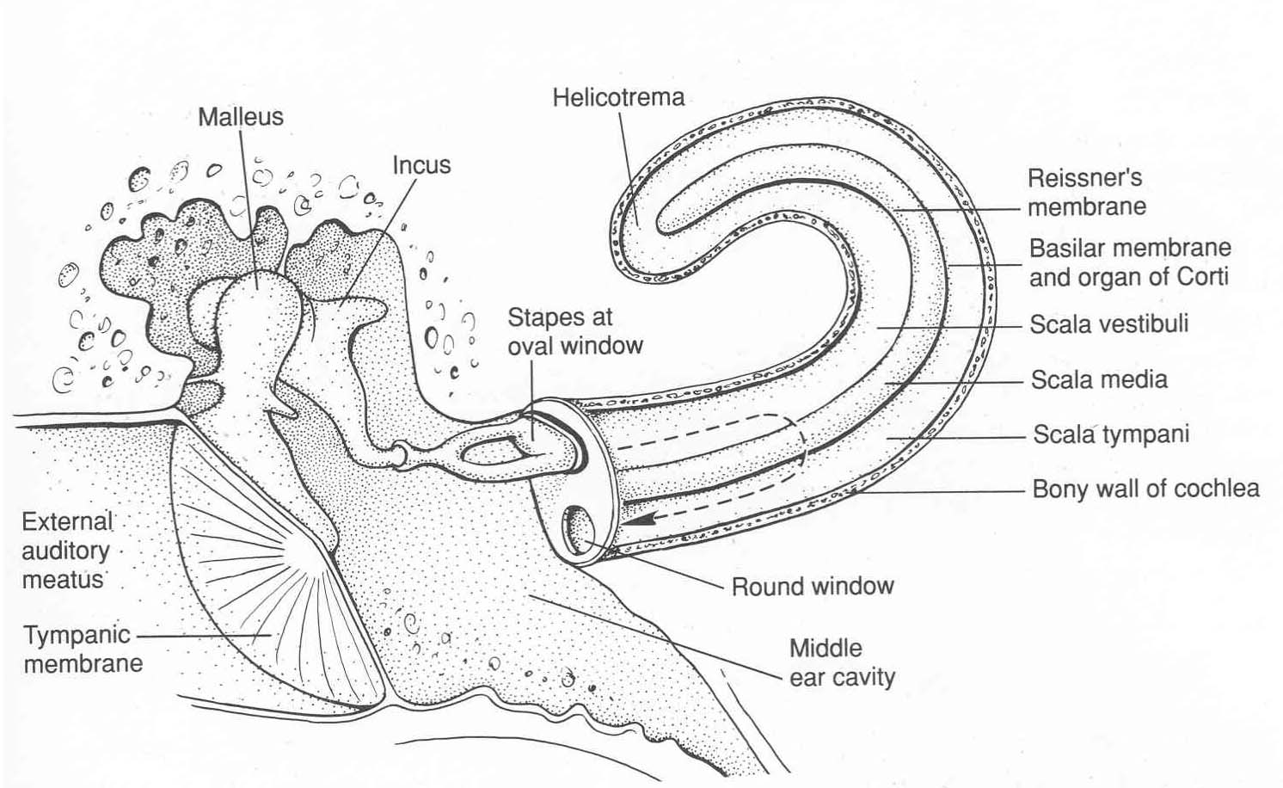
The Auditory Periphery
Bear et al.
Kandel et al.
The outer ear and canal guide and filter sound. The tympanic membrane and ossicles transmit the vibrations to the cochlea itself; the vibrations enter the cochlea via the round window and exit via the round window. As they pass through the endolymph of the scala vestibuli and tympani, sound waves cause the basilar membrane to vibrate. This is the key to auditory function.

Slide 21
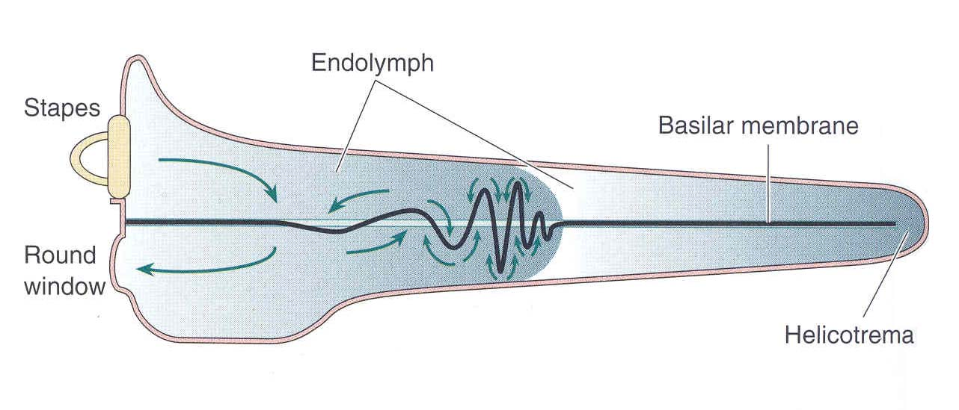
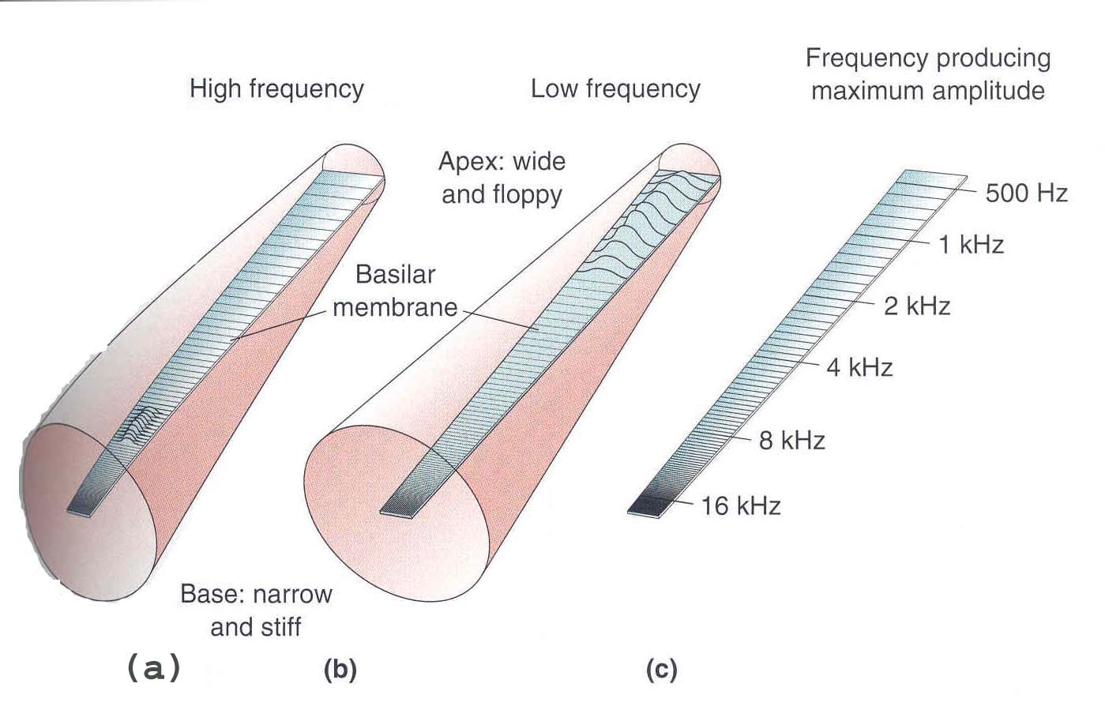
The Cochlea
Sound waves cause the basilar membrane to vibrate.
The basilar membrane is stiff at its base and loose at its apex. Just like a guitar string, this causes it to resonate to high frequencies at its base and low frequencies at its apex. There is therefore a tonotopic map- a location code- formed on the cochlea.This is a fundamental feature of auditory coding and is preserved right up to cortex.
Note that this is a separate code from synchronization.
Bear et al.

Slide 22
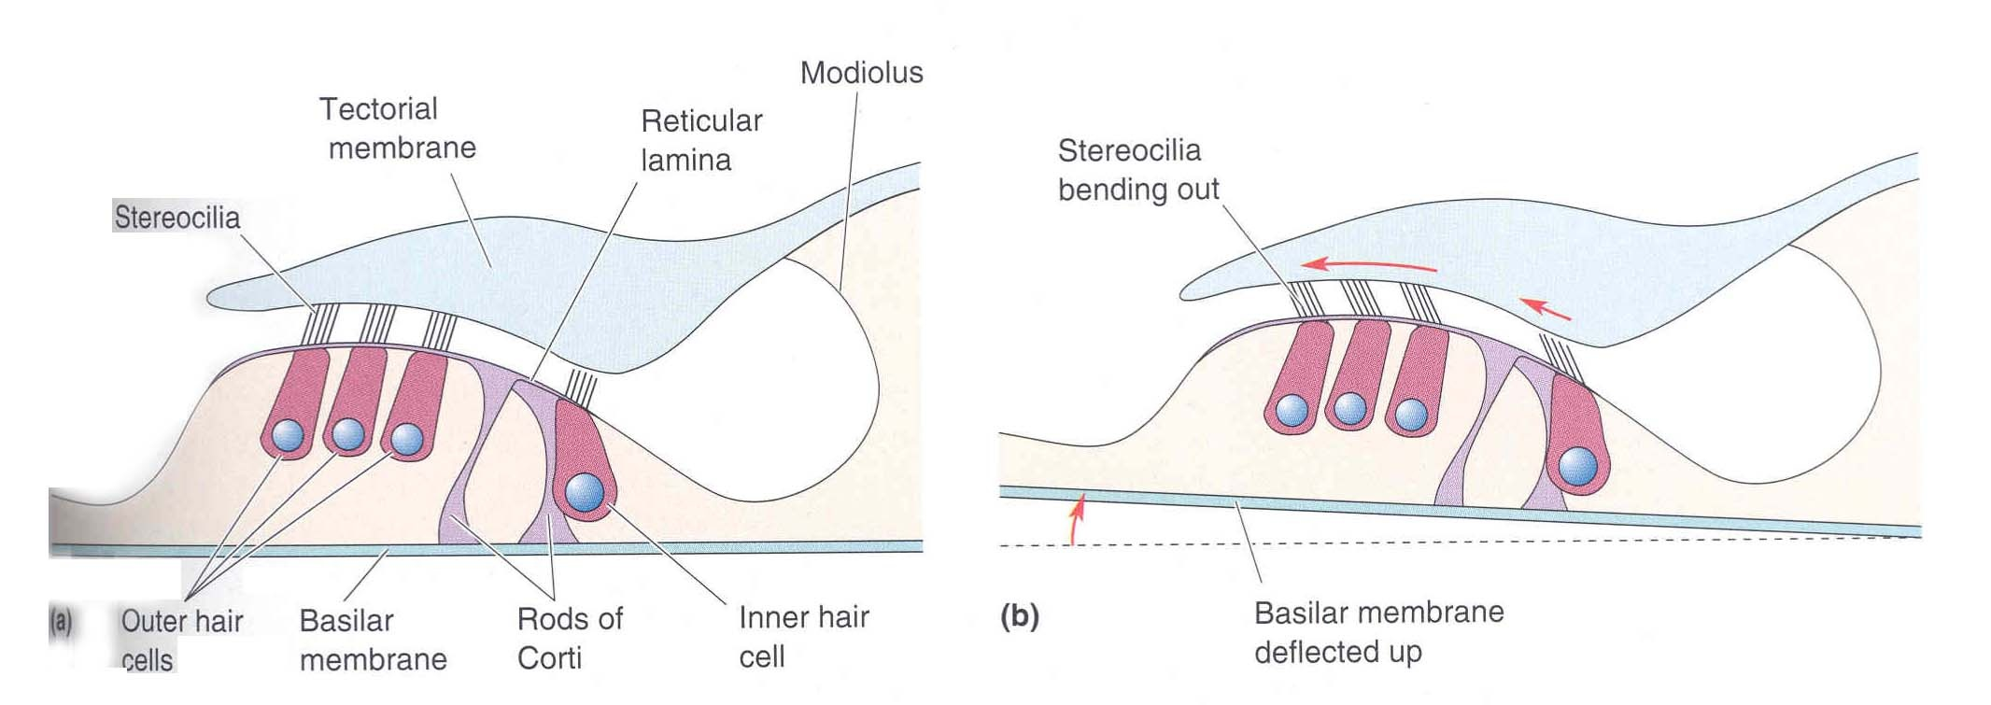
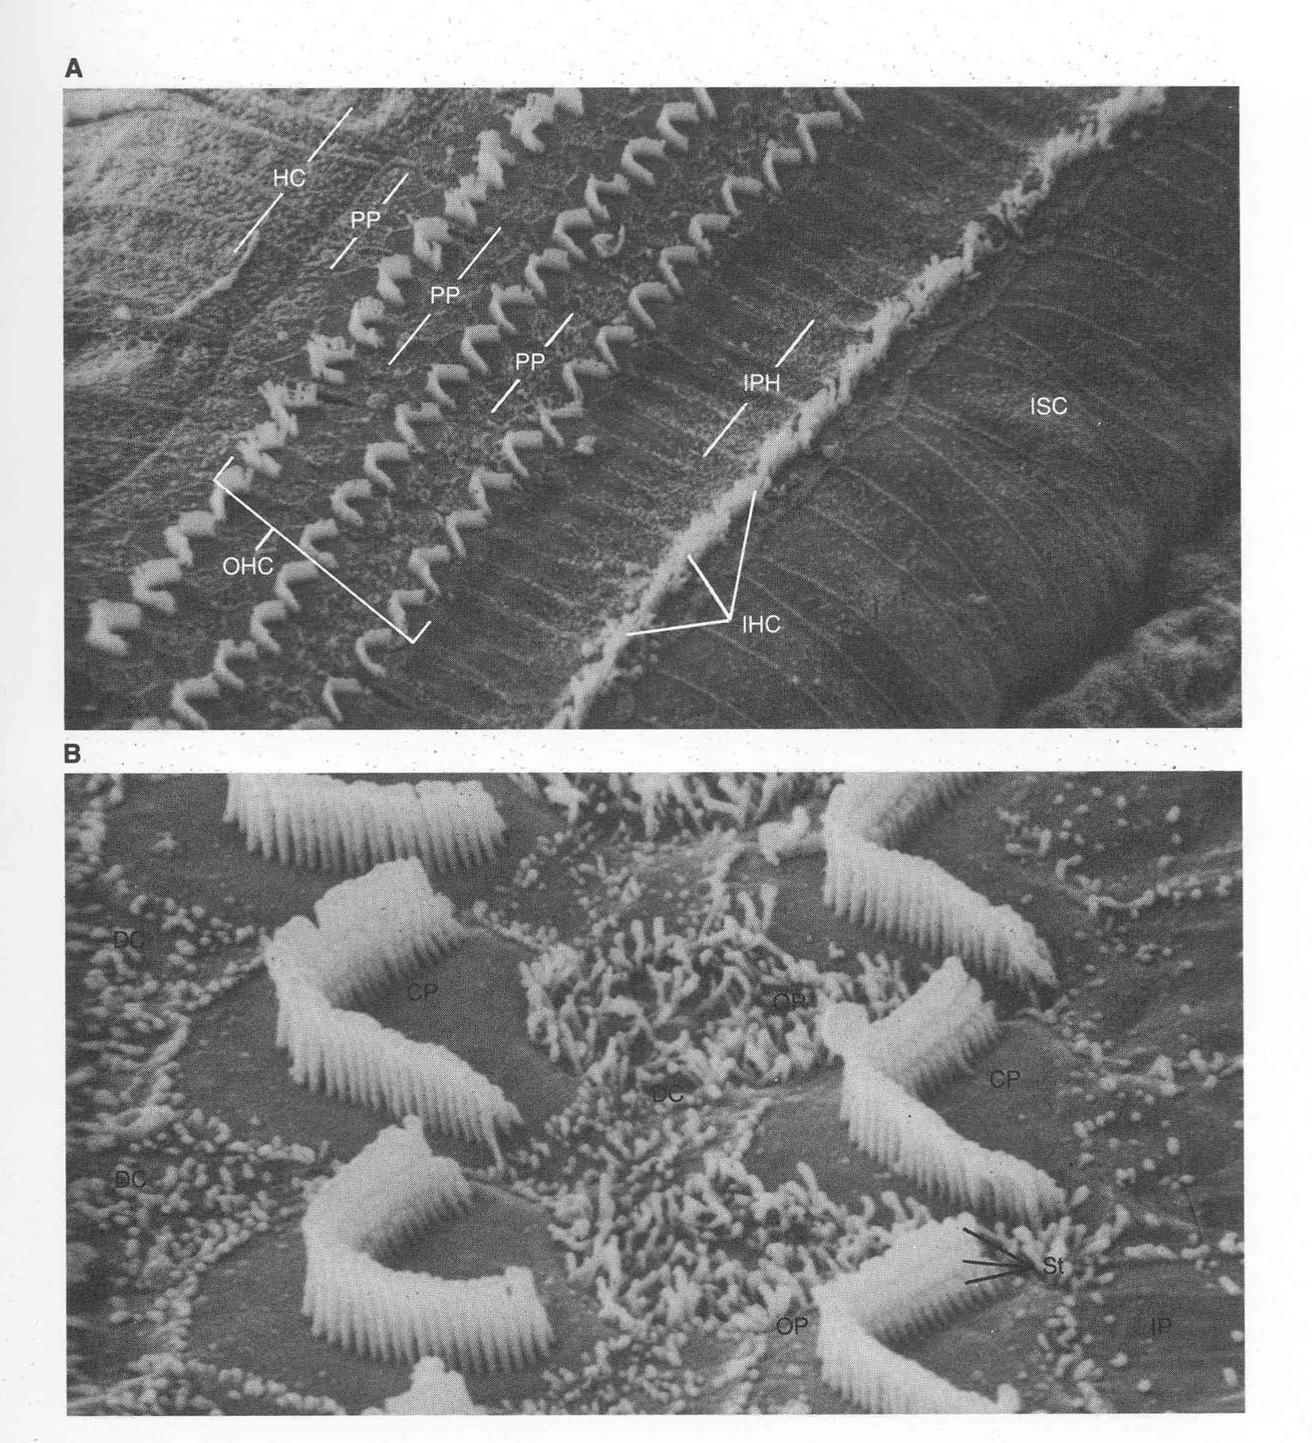
Hair Cells
Bear et al.
Hair cells transduce vibrations into depolarization. This in turn leads to vesicular release that excites auditory afferent fibers and causes them to discharge.
Hair cells are firmly attached to the basilar membrane and therefore move up and down with it as it vibrates. The “hairs” or cilia of these cells are attached to a tectorial membrane; this membrane is fixed- it does not vibrate in response to sound. So when the basilar membrane moves upward, the cilia will be bent.
A scanning electron microscopic view of the beautiful organization of hair cell cilia in the cochlea.
Kandel et al.

Slide 23
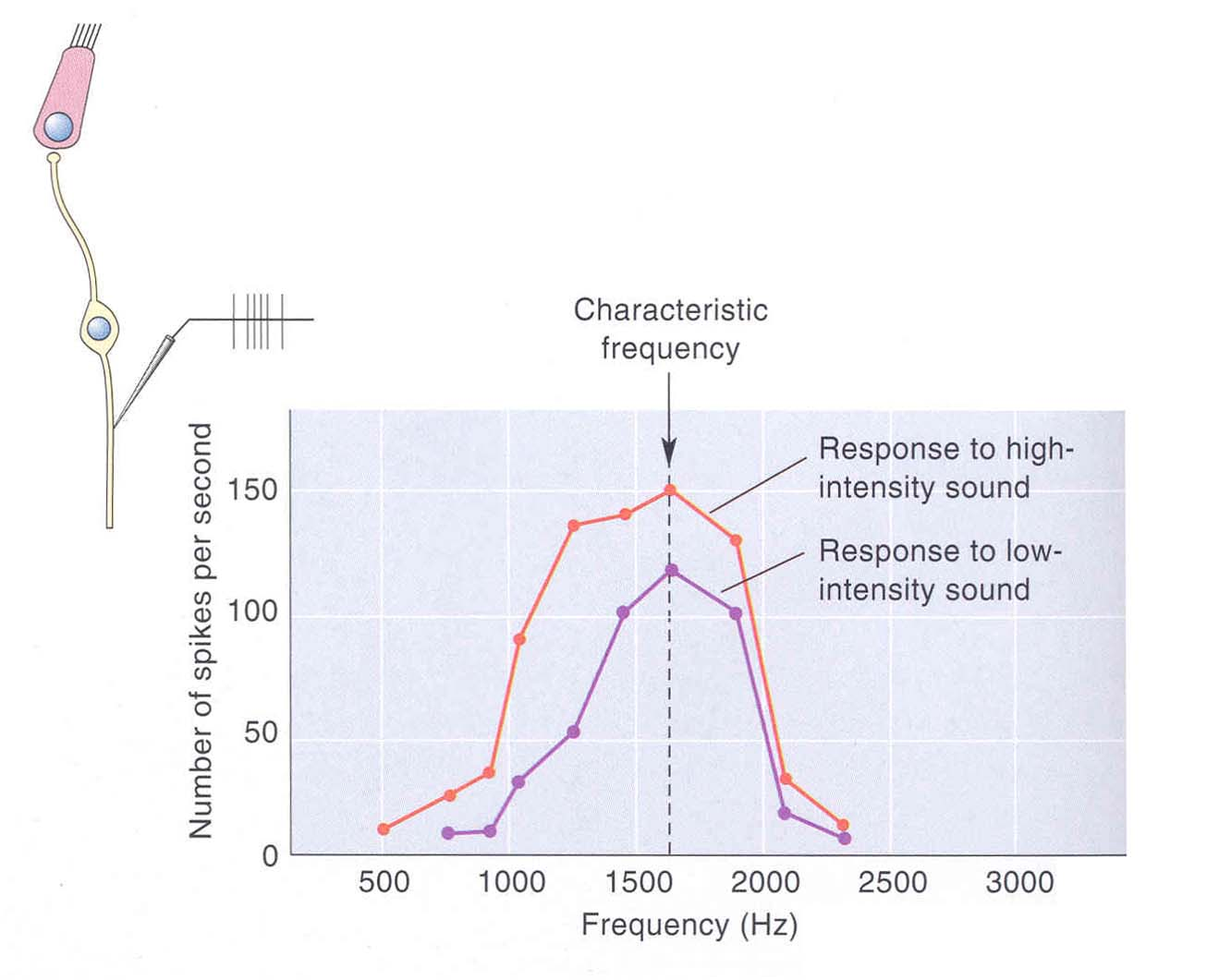
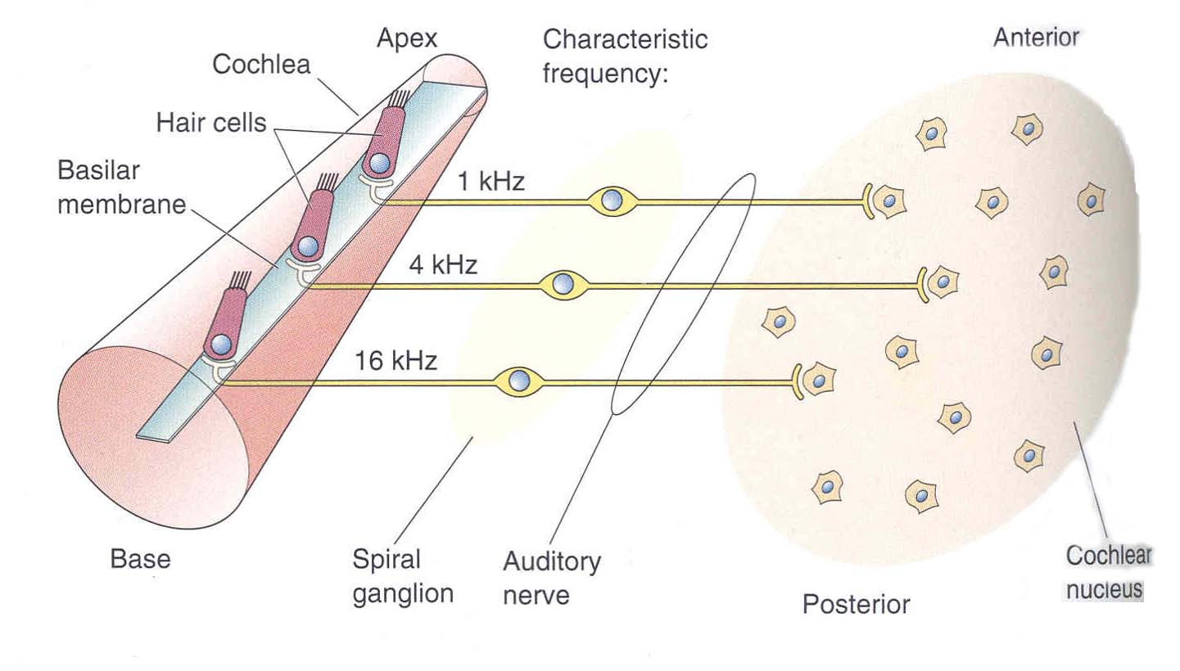
Auditory Afferent fibers
The tuning is simply due to the location of its hair cell along the cochlea. This tonotopic mapping is preserved in the projection of cochlear afferents to the cochlear nuclei in the medulla.
Each auditory afferent fiber is tuned to a specific frequency.
Bear et al.

Slide 24
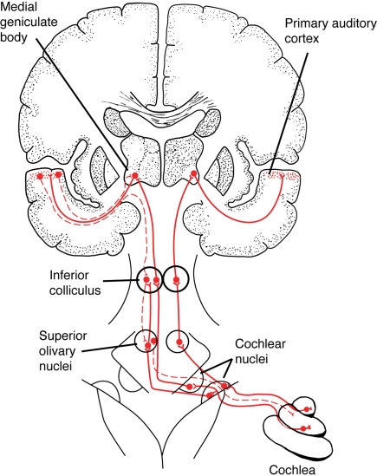
Central Auditory Pathways
https://www.researchgate.net/publication/51484381_Why_would_Musical_Training_Benefit_the_Neural_Encoding_of_Speech_The_OPERA_Hypothesis/figures?lo=1

Slide 25
Central Auditory Pathways
Auditory signals reach the cochlear nuclei of the medulla (DCN, VCN). From these nuclei a direct pathway goes to the Inferior Colliculus, then the thalamic medial geniculate nucleus (MGN) and then onto the auditory primary cortex.
On the way up to cortex axons from VCN also terminate in nuclei of the superior olivary complex. Neurons in this cell group use relative sound timing and intensity in the two ears to estimate the spatial location of a sound source.
Bear et al.

Slide 26
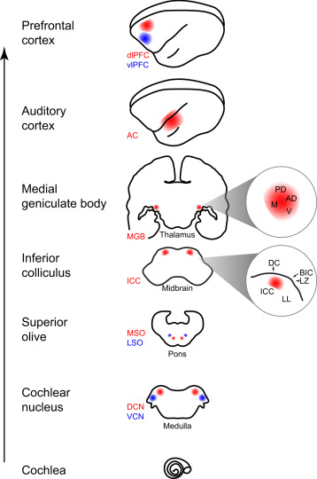
https://www.sciencedirect.com/topics/neuroscience/cochlear-nucleus

Slide 27
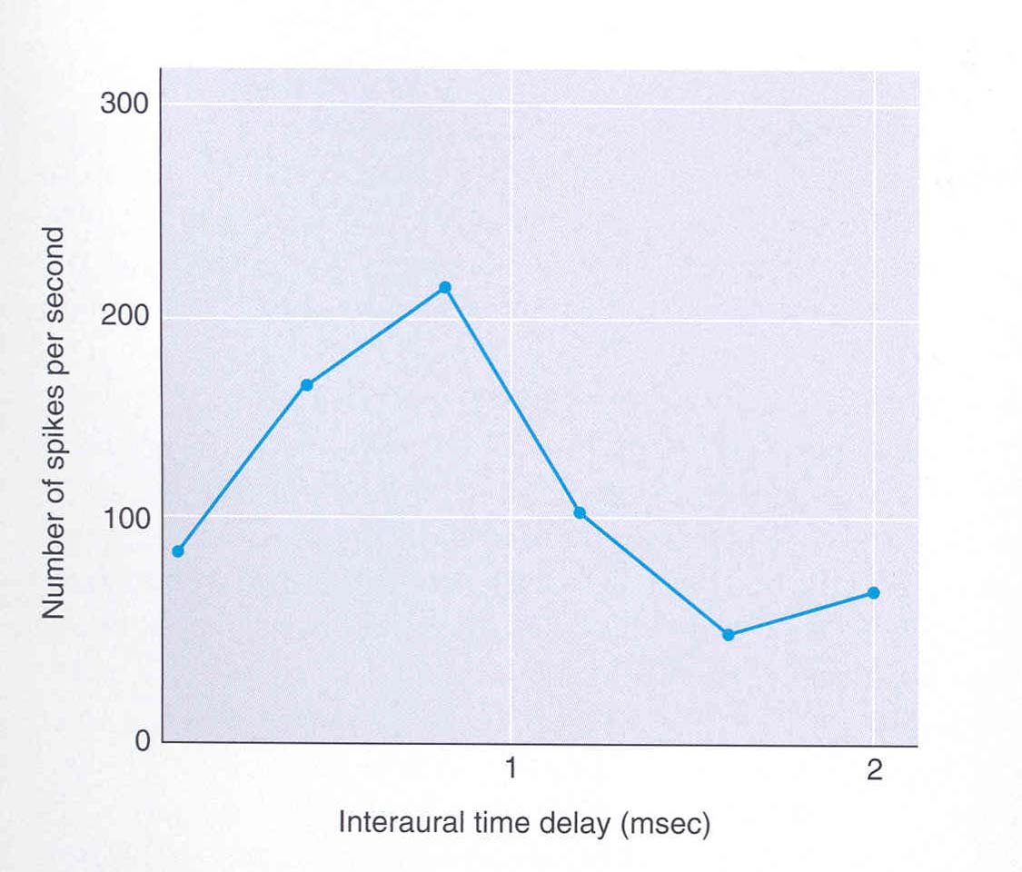
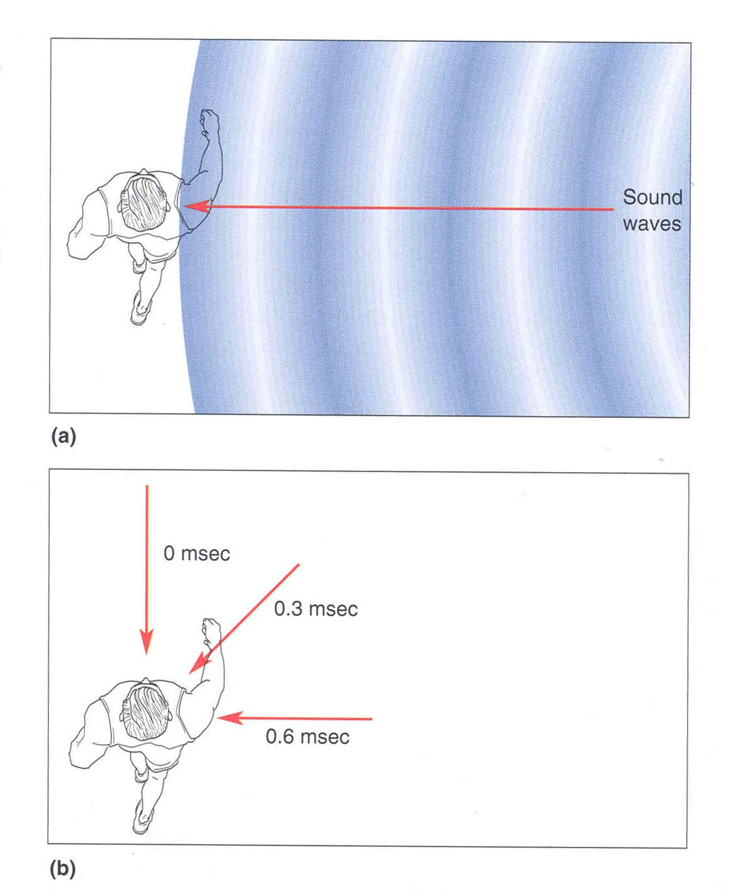
Sound Localization
A cell in the superior olive responds to:
- The time difference in the arrival of sound to the ears.
The relative sound intensity
This can be used to localize sound source
Sounds coming from the right arrive at the right ear a little earlier than the at the left ear. This small time difference is used by the superior olive.
Bear et al.

Slide 28
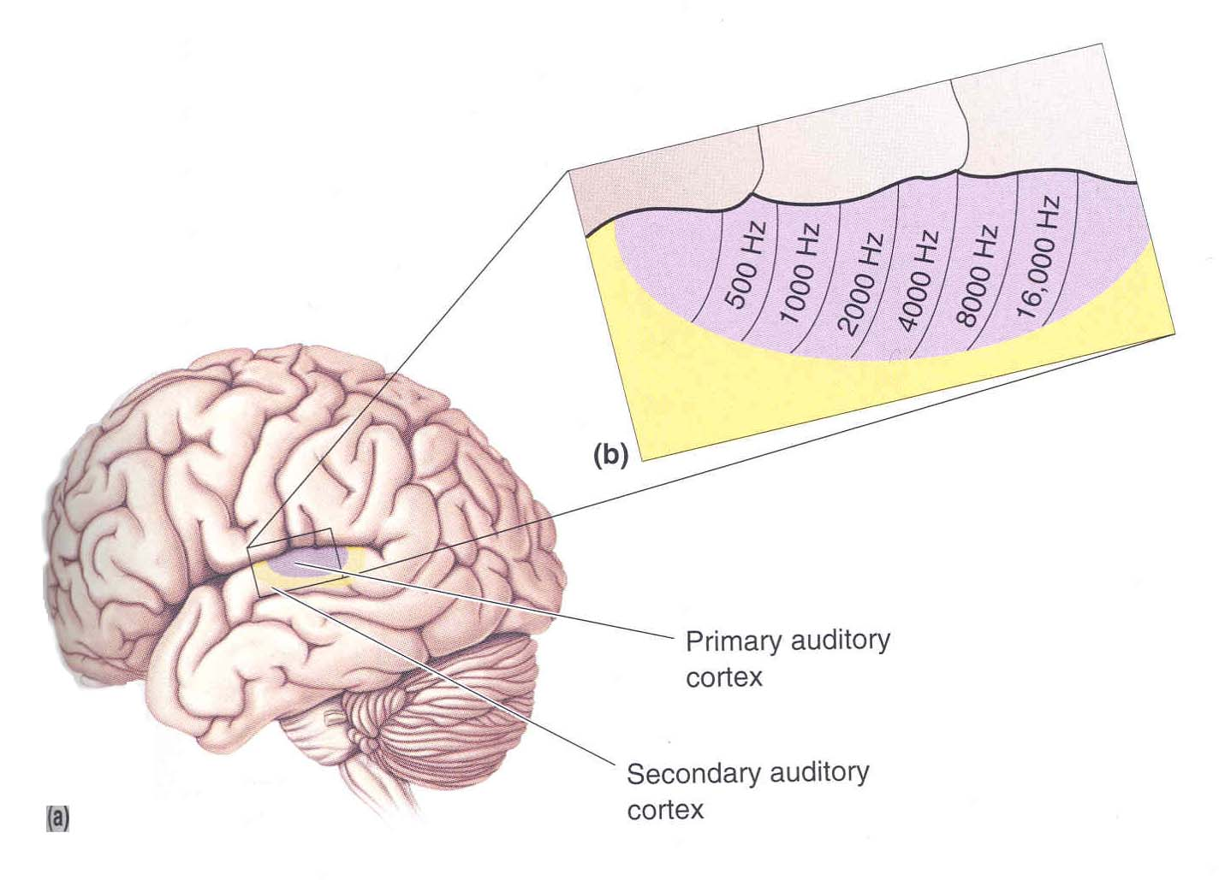
Cortical Processing of Sounds
Bear et al.
Primary auditory cortex has tonotopy – a map of frequencies on cortical surface.
However auditory cortex neurons also respond to complex features of sound such as modulations of amplitude or frequency

Slide 29
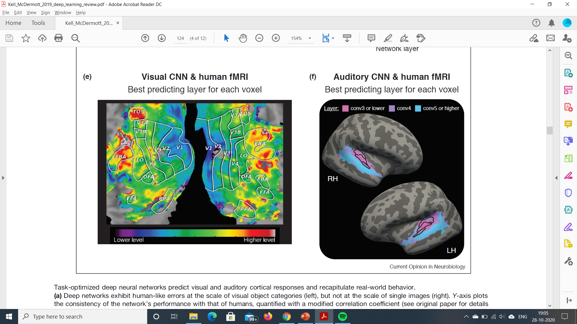
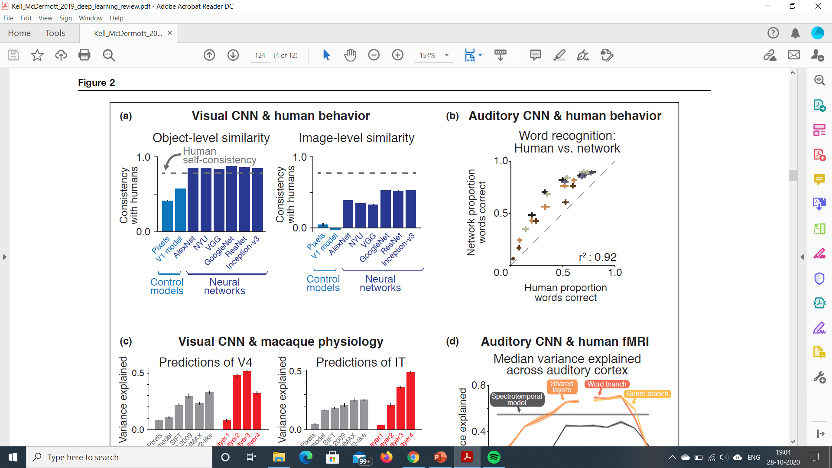
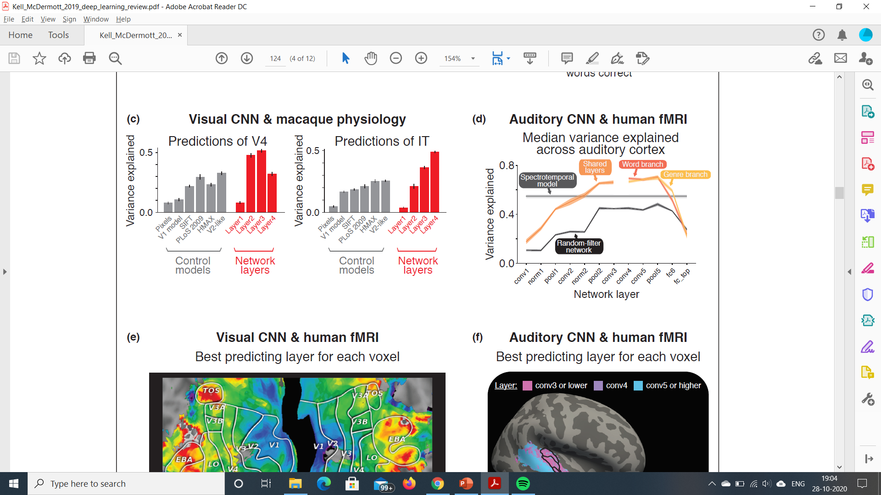
COMPARISON WITH AUDITORY SYSTEM

Slide 30
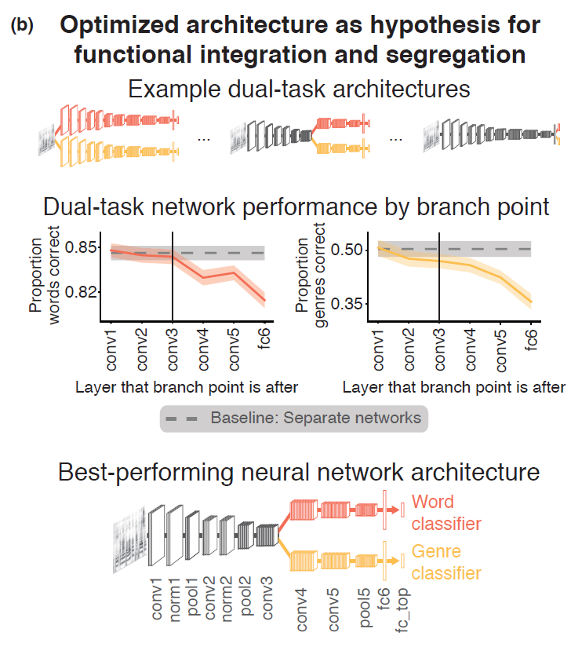
Similar study done on auditory task
Word classification vs genre classification
Several architectures tried.
Best one shared lower layers – used to extract features, while higher layers split into two branches each performing one task
Network sheds light on how the brain processes speech and music.

Slide 31
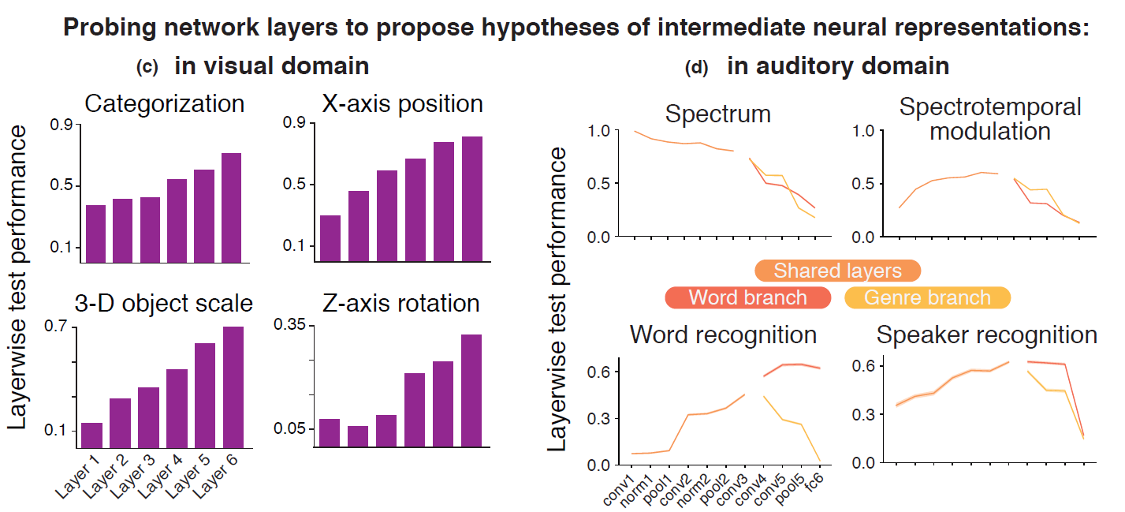

Slide 32
LIMITATIONS
Backpropagation, widely used by DNNs, might not be biologically realistic
Recurrent connection in order to account for feedback connections in the brain
Action potential and neuromodulators – difficult to incorporate in neural networks
Biological learning – brain doesn’t require several 100s of labelled data in order to learn
Optimisation – DNNs can be optimised to perform much better than humans indicating a divergence after a point
DNNs optimised to perform a single task, brain performs multiple dissimilar ones.

